Slide 1
IMPLEMENTATION OF MQTT-SN BROKER
PAVAN KASHYAP
MATRKL NUM: 1186732

Slide 2
AGENDA:
INTRODUCTION
MQTT-SN vs MQTT
MESSAGE INTERFACE
ABOUT BROKER
TCP vs UDP
SQLite DATABASE
IMPLEMENTATION
CONCLUSION
REFERENCES

Slide 3
INTRODUCTION
MQTT-SN stands for Message Queue Telemetry Transport for sensor networks.
It is an open and lightweight protocol designed specifically for machine-to-machine and mobile applications.
Implements a well known data centric communication system – PUBLISH/SUBSCRIBE (Pub-Sub).
MQTT-SN is optimized for implementation on low-cost, battery-operated devices with limited processing and storage resources.
MQTT-SN allows to build up a network of constrained devices with a central broker connected to many clients.

Slide 4
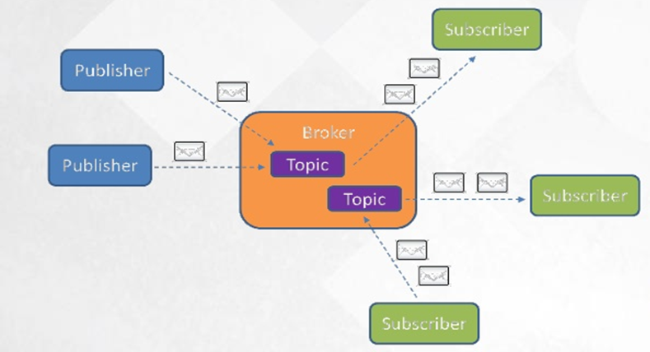
PUB-SUB MECHANISM:

Slide 5
ADVANTAGES OF MQTT-SN VS MQTT
MQTT-SN supports topic ID instead of topic name. Client sends a registration request with topic name and topic ID (2 octets) to a broker. This saves media bandwidth and device memory.
The CONNECT message is split into three messages. The two additional ones are optional and used to transfer the Will topic and the Will message to the server.
“Pre-defined” topic ids and “short” topic names are introduced, for which no registration is required. Predefined topic ids are also a two-byte long replacement of the topic name.
A discovery procedure helps clients without a pre-configured server/gateway’s address to discover the actual network address of an operating server/gateway.
The semantic of a “clean session” is extended to the Will feature, i.e. not only client’s subscriptions are persistent, but also Will topic and Will message.
A new offline keep-alive procedure is defined for the support of sleeping clients.

Slide 6
DISADVANTAGES OF MQTT-SN vs MQTT
Disadvantage is that you need some sort of gateway, which is nothing else than a TCP or UDP stack moved to a different device. This can also be a simple device (e.g.: Arduino Uno) just serving multiple MQTT-SN devices without doing other job.
MQTT-SN is not well supported. Doing datagrams directly to the cloud is inefficient and error prone, hence the gateway in the middle which basically collects these datagrams, and moves stuff to the cloud via reliable, TCP-based MQTT.

Slide 7
IMPLEMENTED ARCHITECTURE
MQTT-SN CLIENT
MQTT-SN BROKER
MQTT-SN CLIENT

Slide 8
We have centralized MQTT-SN Broker which serves to all the requests in an asynchronous way. This server also updates the key values to the database and data can be retrieved when required.
We have multiple clients connected to the server and communication between them is through PUB-SUB mechanism but it is based on the TopicID and hence restricting the number of message bytes to as small as possible.
The client implements 4 major functionalities such as CONNECT, REGISTER, SUBSCRIBE & PUBLISH.
Appropriate responses from the server is sent as an Acknowledgment to requests obtained based on the response codes generated. The acknowledge messages are CONNACK, REGACK, SUBACK and PUBACK.

Slide 9
MESSAGE INTERFACE
The general message format of all messages are given below:
Message header: The message headers contain the information about the length of the total message and also the kind of message received/sent.
Message Type field values are given in table below:
MESSAGE HEADER (2 to 4 Octets) | MESSAGE VARIABLE PART (n Octets)
LENGTH (1 to 3 Octets) | MESSAGE TYPE (1 Octet)
MsgType field value | MsgType | MsgType field value | MsgType
0x04 | CONNECT | 0x05 | CONNACK
0x0A | REGISTER | 0x0B | REGACK
0x0C | PUBLISH | 0x0D | PUBACK
0x12 | SUBSCRIBE | 0x13 | SUBACK

Slide 10
Message Variable Part
The content of the message variable part depends on the type of the message. Few are given below:
CLIENTID: the CLIENTID field has a variable length and contains a 1-23 character long string that uniquely identifies the client to the server.
DATA: The DATA field corresponds to payload of an MQTT PUBLISH message. It has a variable length and contains the application data that is being published.
DURATION: The DURATION field is 2-octet long and specifies the duration of a time period in seconds.
MSGID: The MSGID field is 2-octet long and it allows the sender to match a message with its corresponding acknowledgment.
PROTOCOLID: The PROTOCOLID is 1-octet long. It is only present in a CONNECT message and corresponds to the MQTT ‘protocol name’ and ‘protocol version’.

Slide 11
TOPICID: The TOPICID field is 2-octet long and contains the value of the topic id. The values “0x0000” and “0xFFFF” are reserved and therefore should not be used.
TOPICNAME: The TOPICNAME field has a variable length and contains an UTF8-encoded string that specifies the topic name.
FLAGS: The FLAGS field is 1-octet and contains many flags such as:
DUP: value ‘0’ – Message transmitted once & ‘1’ – retransmission.
QOS: 3 types of QOS are present.
CleanSession: For a clean connect connection
RETURNCODE: This field is 1 octet long and the meaning is as follows:
RETURN CODE VALUE | MEANING
0x00 | ACCEPTED
0x01 | REJECTED: CONGESTION
0x02 | REJECTED: INVALID TOPICID
0x03 | REJECTED: NOT SUPPORTED
0x04 – 0xFF | RESERVED

Slide 12
MESSAGE STRUCTURE
CONNECT: The CONNECT message is sent by a client to setup a connection.
CONNACK: The CONNACK message is sent by the server in response to a connection request from a client.
REGISTER: The REGISTER message is sent by the client to the server to register the short TopicID and hence mapping it with TopicName.
REGACK: The REGACK message is sent by the Broker as an acknowledgment to the receipt and processing of a REGISTER message.
Length (Octet0) | MsgType (1) | Flags (2) | Protocol ID (3) | Duration (4,5) | ClientId (6:n)
Length (Octet 0) | MsgType (1) | Return Code (2)
Length (Octet0) | MsgType (1) | TopicID (2, 3) | MsgID (4, 5) | TopicName (6:n)
Length (Octet0) | MsgType (1) | TopicID (2, 3) | MsgID (4, 5) | ReturnCode (6)

Slide 13
PUBLISH: This message is used by both clients to publish data for a certain TopicID. Based on the Subscriptions sent from the clients which requests data to be published to them based on the TopicID.
PUBACK: The PUBACK message is sent by the Broker as an acknowledgment to the receipt and processing of a PUBLISH message.
SUBSCRIBE: The SUBSCRIBE message is used by a client to subscribe to a certain topic. All the message fields of this message are fixed except TopicID or TopicName.
SUBACK: The SUBACK message is sent by the Broker to a client as an acknowledgment to the receipt and processing of a SUBSCRIBE message.
Length (Octet0) | MsgType (1) | Flags (2) | TopicID (3, 4) | MsgID (5, 6) | Data (7:n)
Length (Octet0) | MsgType (1) | TopicID (2, 3) | MsgID (4, 5) | ReturnCode (6)
Length (Octet0) | MsgType (1) | Flags (2) | MsgID (3, 4) | TopicID or TopicName (5,6 or 5-n)
Length (Octet0) | MsgType (1) | Flags (2) | TopicID (3, 4) | MsgID (5, 6) | Return Code (7)

Slide 14
MQTT-SN BROKER:
MQTT-SN Broker enables applications to interact with sensor and other things. It executes information queries on behalf of applications.
Broker collects and aggregates the received information. Here in this project we have implemented an MQTT-SN Broker which uses TCP as the transport layer protocol.
The broker acts as a conduit and controls the message to and from the client based on pub-sub mechanism and registration of topics.
To reduce the size of the payloads, the data packets are numbered by numeric topic ids rather than long topic names. This particular feature elegantly reduces the size of the packets

Slide 15
WHY TCP over UDP?
TCP as we know is a connection based protocol, meaning that a connection needs to be setup before the transfer of data can start.
TCP is a reliable protocol, meaning that the data that is sent is reached by the receiving party, which is not an entity in UDP.
TCP enables data to be received in an ordered way, meaning if 5 data packets are sent, then data packet 1 should be received before data packet 2.
UDP does not give guarantee that data will reach the destination. It does not gives guarantee that data will be in the same order and it also does not give guarantee that data will reached on destination without any duplication.
TCP provides Flow and Congestion control whereas UDP does not.

Slide 16
SQLite DATABASE
Client/server SQL database engines strive to implement a shared repository of enterprise data. SQLite strives to provide local data storage for individual applications and devices.
SQLite is very fast. It runs on the same machine, so there is no networking overhead when executing queries or reading results.
SQLite runs on mobile devices where resources are scarce and efficiency is crucial.
SQLite's speed makes up for one of its (perceived) greatest shortcomings, which is database-file locking for writes.
SQLite is extensible. Because SQLite is embedded by your application, it runs in the same address space and can execute application code on your behalf. SQLite is very easy to configure and it’s very easy to manage as it is only one file.

Slide 17
Database Structure:
The database contains 4 tables called Clients, Register, Subscriber, Publisher for 4 messages receiving from the client respectively. The tables will be updated as and when the client messages are received and data is extracted.
Clients Table Structure:
Register Table Structure:
Subscriber Table Structure:
Publisher Table Structure:
Client_ID (string) | Status (bool) | KeepAlive (integer) | UpdateTime(DateTime)
TopicID(string) | TopicName(string)
SubscriberID (string) | SubscriberTopicID(string)
TopicID (string) | TopicName(string) | Message(string) | SubscriberPendingID (string)

Slide 18
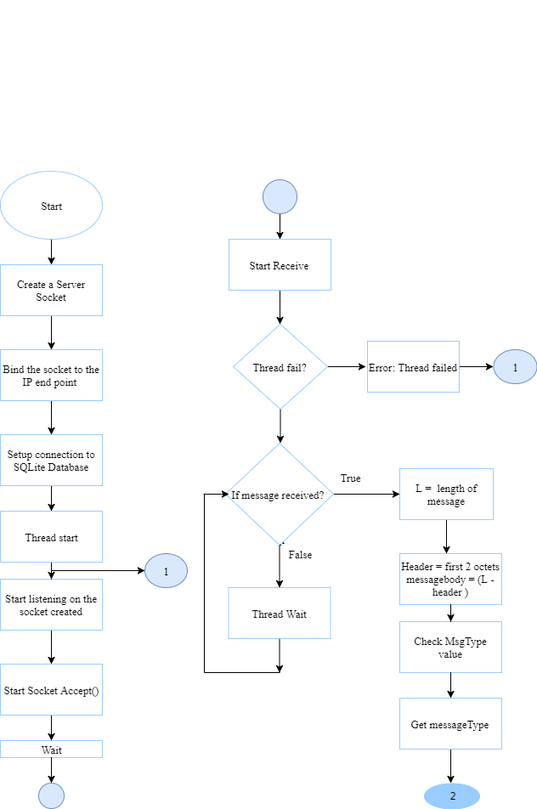
Working Flow:

Slide 19
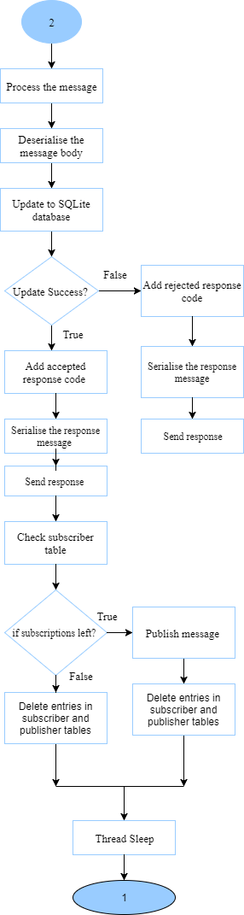

Slide 20
CONCLUSION
Avoids UTF-8 encoded string payloads to carry topic names in every publish message by using pre-defined topic IDs, short topic names and dynamic topic IDs. This reduces the size of publish messages considerably.
For low powered device adopting offline keep alive mechanism to buffer data to be delivered by the server/broker.
Apart from this the messages are received in order as the broker used is TCP. Packet loss is reduced.
Database is hosted along with the application and hence operating it is easy and fast process.

Slide 21
THANK YOU

Slide 22
Q & A?

